Slide 1
A PRESENTATION ON TELECOM CHURN
Presented by
Mr. Khetal Sarode

Slide 2
PROBLEM STATEMENT
All over the world, Numerous telecom companies are present. To keep up in the competition and expand their business companies have to invest in the market. But, due to increasing competition, company is facing severe loss of revenue and loss of potential customers. So, they want to find out the reasons of losing customers by measuring customer loyalty to regain the lost customers

Slide 3
APPROACH
In given data, dependent variable is churn which has values either TRUE or False.
True indicates that customer is going to leave the company.
Since the churn variable is dichotomous, logistic regression algorithm is chosen
to analyze the revenue loss.
Since the data contains some missing values some data preprocessing needs to be done. Further, regression algorithms work well with numeric data so categorical variables has to be converted into numeric form.

Slide 4
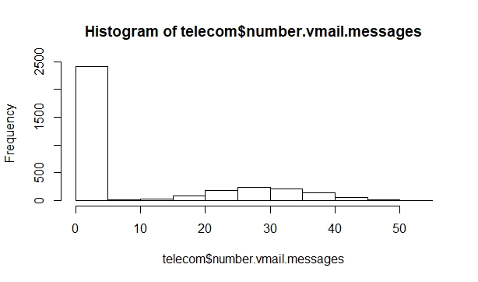
Histogram of Number Vmail Messages

Slide 5
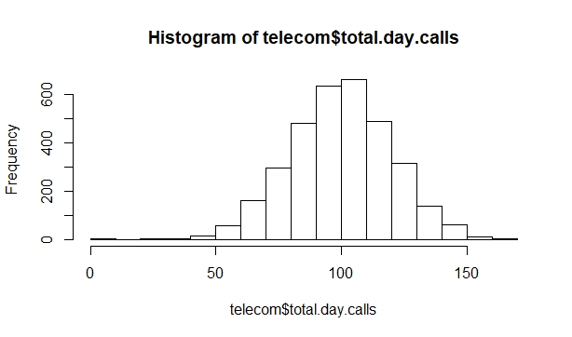
Histogram of Total Days Calls

Slide 6
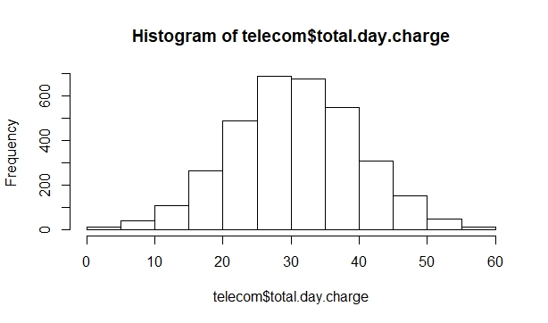
Histogram of Total Day Charge

Slide 7
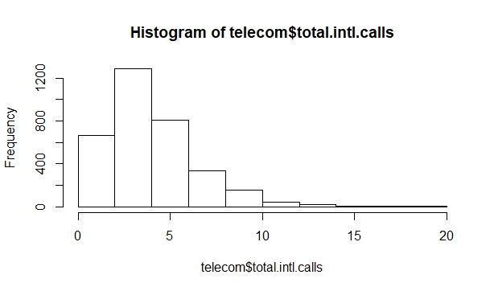
Histogram of Total Intl Calls

Slide 8
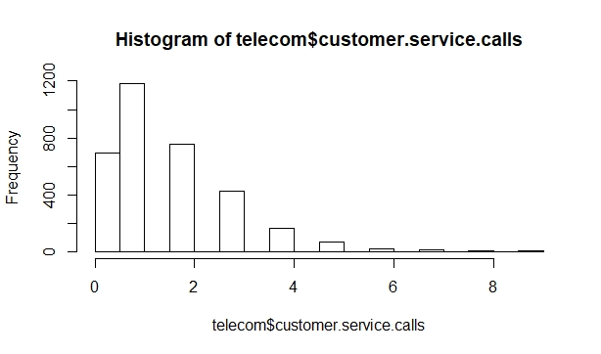
Histogram of Customer Service Calls

Slide 9
INSIGHTS DERIVED
Reasons for customer churn can be found out by building logistic regression model.
The strength of correlation between churn and other variables can be analyzed using
correlation plot.
In addition to that we can visualize the relationship between variables using scatterplot

Slide 10
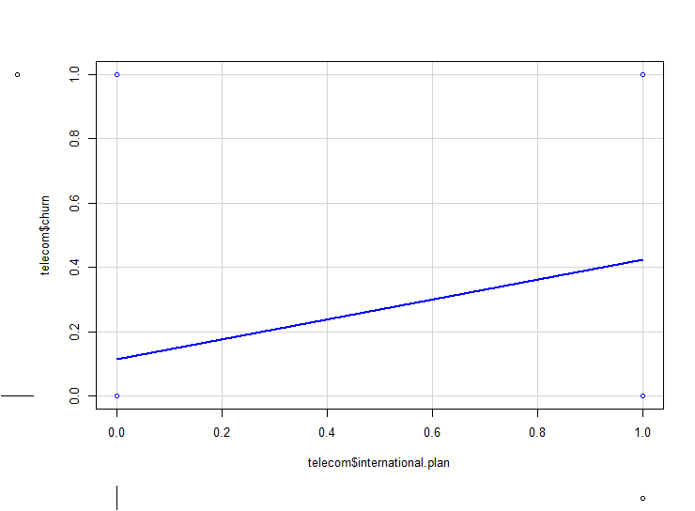
Relation between international plan and churn

Slide 11
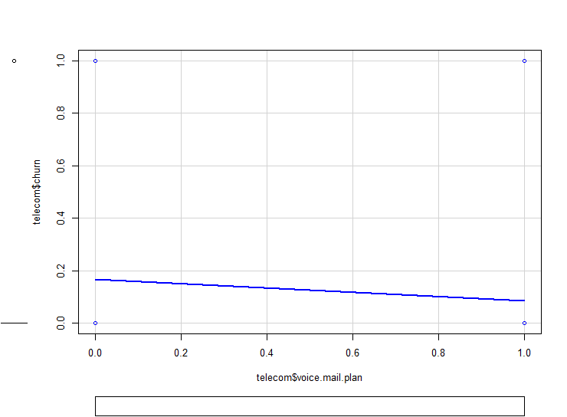
Relation between voice mail plan and churn

Slide 12
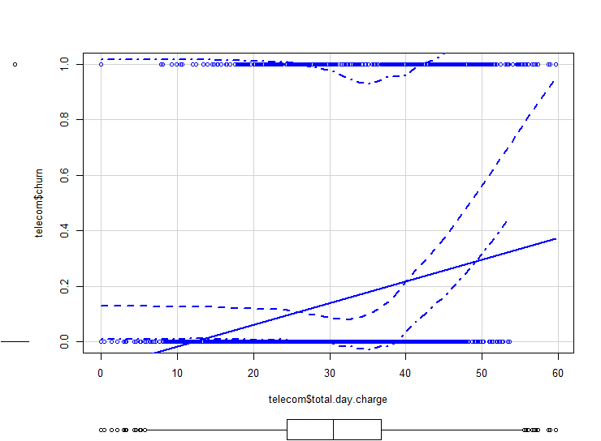
Relation between total day charge and churn

Slide 13
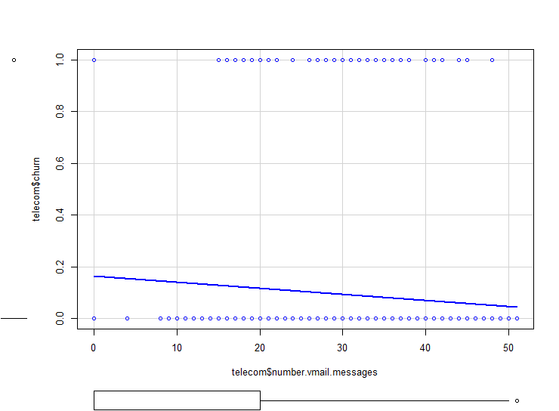
Relation between no. of vmail messages and churn

Slide 14
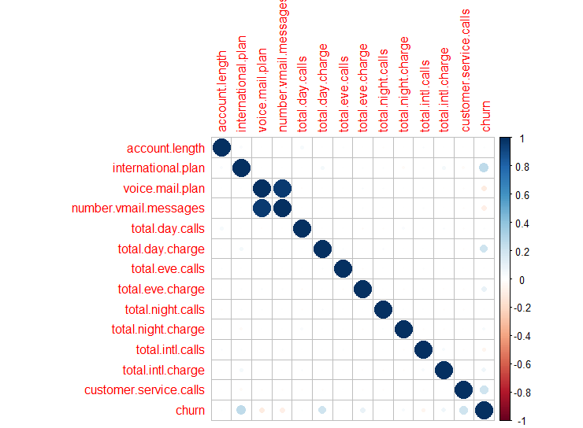
Correlation plot

Slide 15
Insights
From graphs and regression model following insights are derived:
International plan, voice mail plan, number vmail messages, total day charge, total eve charge, total night charge, total intl calls, total intl charge, customer service calls are the variables that are making impact on increasing churn of customers.
Customers having international plan are more likely to churn.
With increase in total day charge and evening charge customers tend to shift to another company. More the service calls higher is churn.
Other variables such as voice mail plan, vmail messages are negatively impacting the churn variable. Lesser is the value of these variables higher is the churn.

Slide 16
RECOMMENDATIONS
Company has to reduce total day and evening charge in order to minimize the frequency of customer churn.
When the value of customers service calls is 6 or above there is more than 40% probability of customers churn.
Company needs to reduce charges of international plans as the analysis shows that customers with international plans are leaving the company.
Company should try increasing vmail messages as customers with 40 to 50 vmail messages shows almost no churn.

Slide 17
THANK YOU…

